Slide 1
Module 5.5: Functions

Slide 2
Why do we need functions?

Slide 3
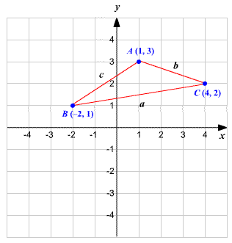
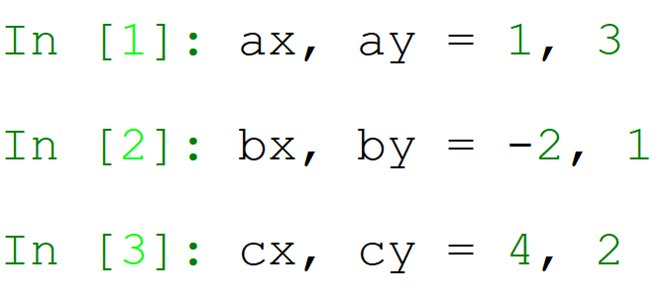
Let’s say we have a triangle…
We’ll save the points using packing/unpacking, that we learned last lesson.

Slide 4
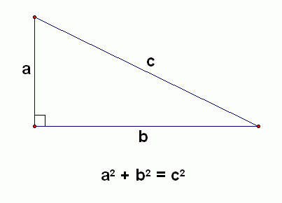
I want to know the triangle’s perimeter…
We’ll do this by using the Pythagorean Theorem.

Slide 5
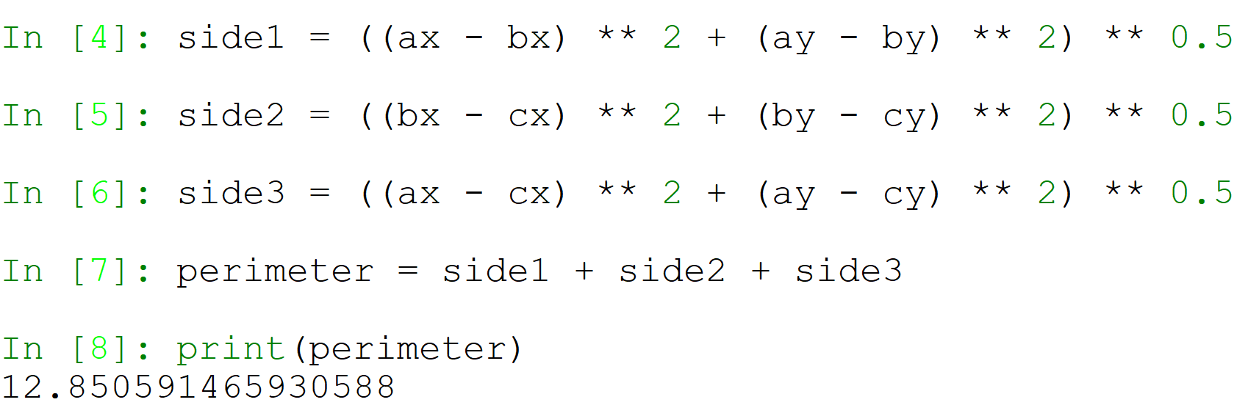
Let’s code!

Slide 6
What’s the problem with this?
We wrote the exact same code 3 times.

Slide 7
Let’s code!

Slide 8
What’s the problem with this?
1. We wrote the exact same code 3 times.
2. The computation isn’t easy or readable. It would be easier if it had a name.
This is what functions are for. They take a set of commands (some code), and give it a name, so that you can reuse them easily.

Slide 9
Rationales for Function Writing
Every function should have ONE purpose or objective.
If the function starts becoming too long, it should be divided into multiple functions.
In this way, there is no more code duplication, and our code becomes more readable.

Slide 10
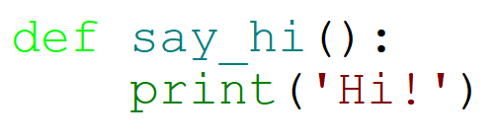
Basic Function Creating
Steps:
Use the def keyword
Function name
Brackets
Colon
Indented function body
This defines (but does not execute) the function.

Slide 11
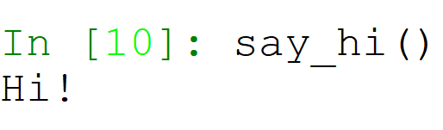
Executing a Function
Just like always!
Steps:
Function name
Brackets

Slide 12
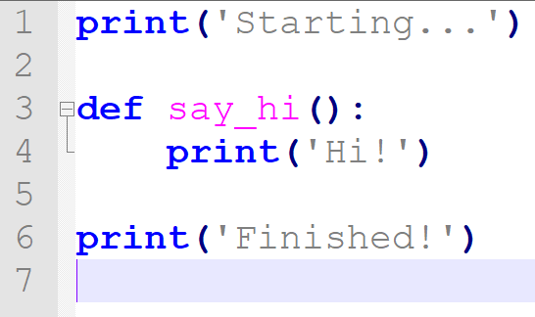
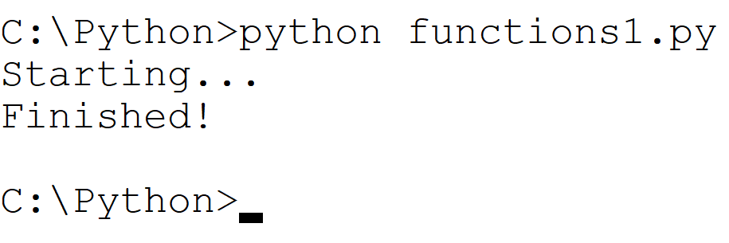
If we don’t call the function, it will not run…

Slide 13
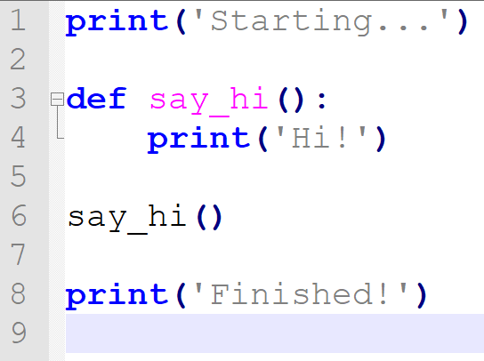
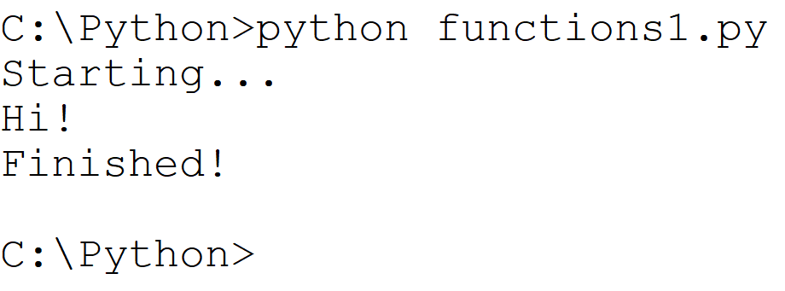
If we don’t call the function, it will not run…

Slide 14
Arguments & Parameters
A function can be added to arguments as inputs. These can also be called parameters.
For example, input receives the argument prompt which is the question to ask the user.
The function print receives inputs to print to the screen.
These arguments are written inside the parentheses, when the function is called.
Dictionary Corner:
Argument – the input given to the function when calling/executing the function.
Parameter – the input given to the function when defining the function.
These are essentially the same, but used in different contexts.

Slide 15
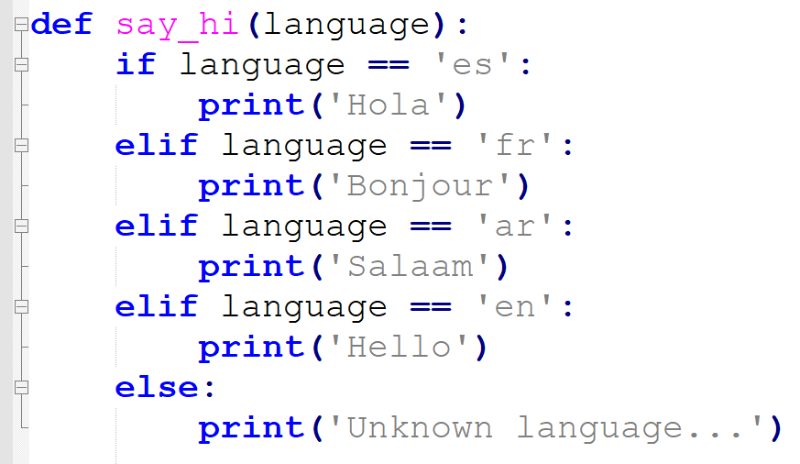
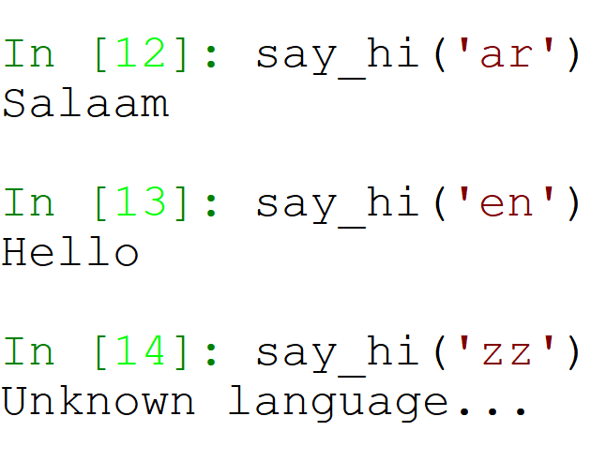
Single Parameter Example
Execution:

Slide 16
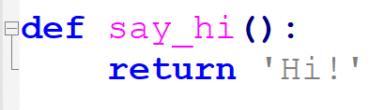
Does this function return anything?
This function, much like the function print, prints to the screen but doesn’t return anything.
In order to return a value, we should use the built-in keyword return.
The return statement ends the function execution and “sends back” the result of the function.

Slide 17
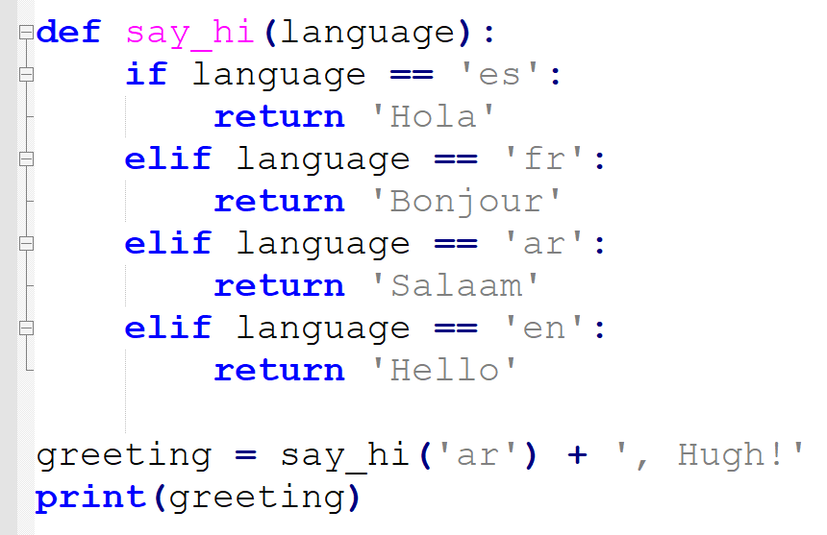
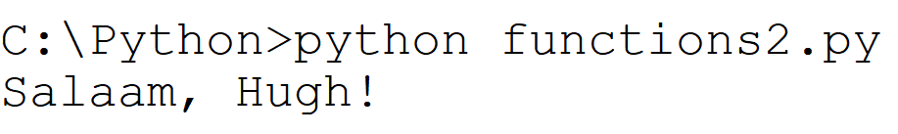
Using return
Again, once the code hits return, the function execution ends, and the value is given back to whatever called the function.

Slide 18
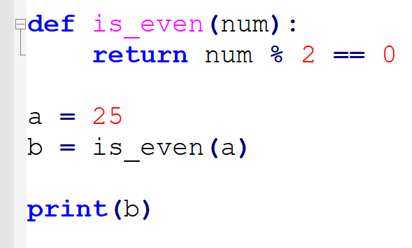
Functions – Step-by-Step
Let’s look at this code.
What will happen?
The first line to be executed will be:
a = 25
Then, is_even(a) will be called.
The code will jump to the function.
A new variable named num will be created, with the value 25.
The value n % 2 == 0 will be calculated and returned (False)
b will now be False
b will be printed. The program will print False.

Slide 19
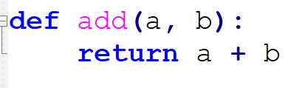
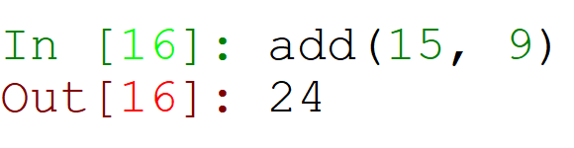
Multiple Parameters
In order to define multiple parameters, we put them in the brackets of the function definition, divided by a comma:
Execution:

Slide 20
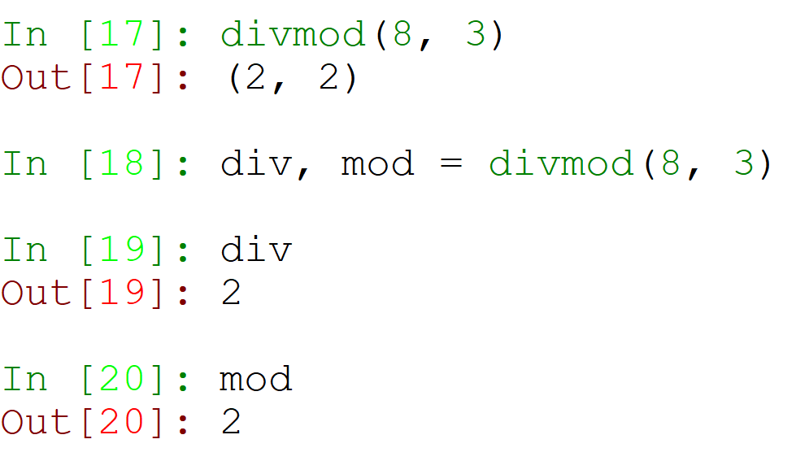
Multiple Return Values
You can also return multiple values.
Let’s take, for example, the built in function divmod – that calculates the integer division value of two numbers, and the remainder:
This function gives a tuple, with two values!

Slide 21
Unpacking Multiple Return Values

Slide 22
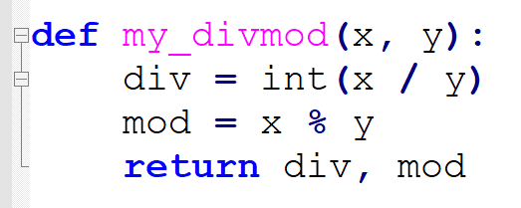
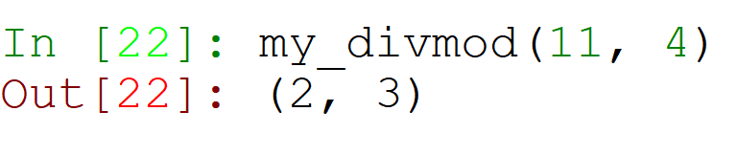
Let’s Create Our Own divmod Function
So, in order for us to return multiple values, we write them both after the return keyword, divided by a comma. This packs them into a tuple!

Slide 23
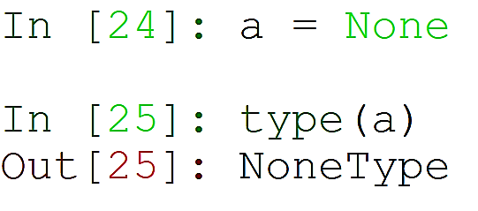
None
There is a special object in Python named None.
It is the only object of type NoneType.
It is customary to use None whenever no value should be returned from a function.

Slide 24
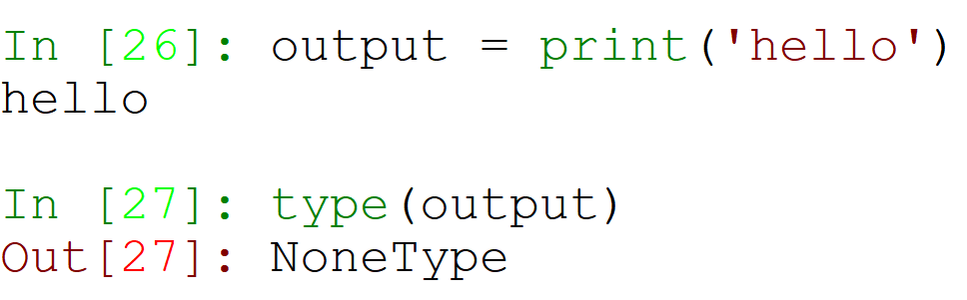
No Function Return Value
Remember when we said that the function print has no output?
In fact, its output is None:

Slide 25
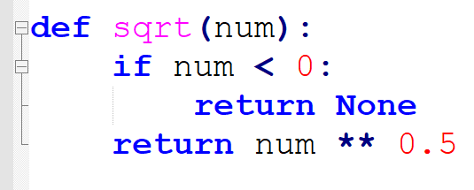
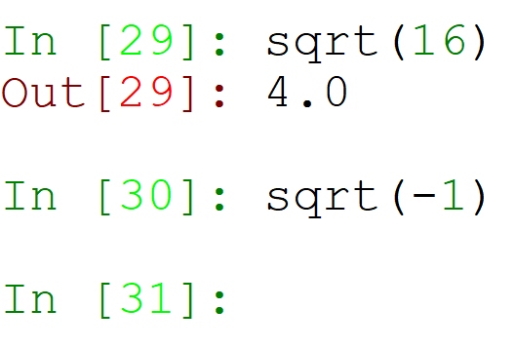
Using None As A Return Value

Slide 26
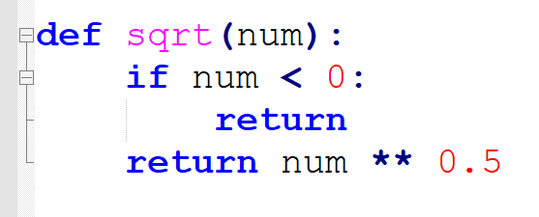
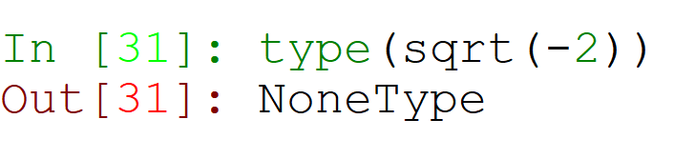
Using No Return Value
Not writing anything after the return keyword is the same as writing None – it also returns None.

Slide 27
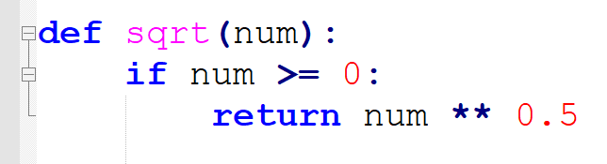
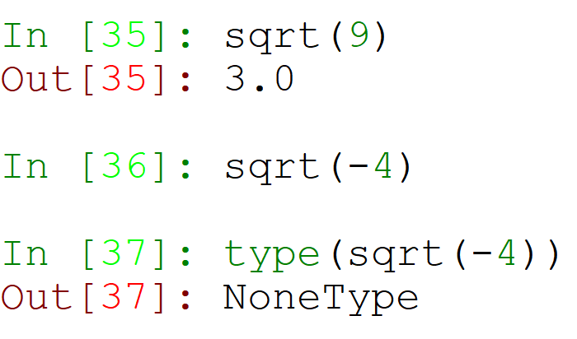
Using No return Keyword
In fact, not using return at all, also returns None!

Slide 28
To function or not to function...
Organize your code into logical chunks – every step of the solution should be a function, with a name!
Don’t repeat yourself - make it work once and then reuse it.
If something gets too long or complex, then break it up into different chunks and put those chunks in functions.

Slide 29
Variables with The Same Name
What if I create a variable, and change it inside the function?
No worries! In every function, all variables are saved in a new area of memory, called a scope. This scope can hold different variable values, without changing the variable values of the outer scope (whoever called the function).

Slide 30
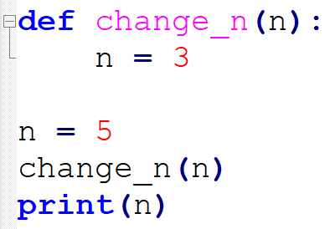
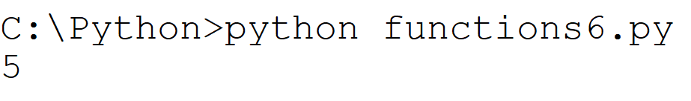
Scope Example

Slide 31
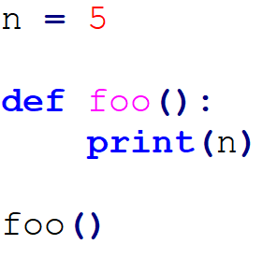
Looking For Variables in Outer Scope
If a variable is called in a function, but there is no such variable in the local scope, Python looks for the variable in the outer scope – called the global scope.

Slide 32
Constants
Because of this attribute of functions, we have constants.
Constants are similar to variables, but instead of varying (changing) throughout the script, they are supposed to stay the same.
Constants are always written at the top, or beginning, of the script.
Constants are written in uppercase letters.
From now, everything you write in your script that is an unchanging value, should be saved as a constant at the beginning of your script.
This will help you manage your code in the future – condensing all values in one known place in your script.

Slide 33
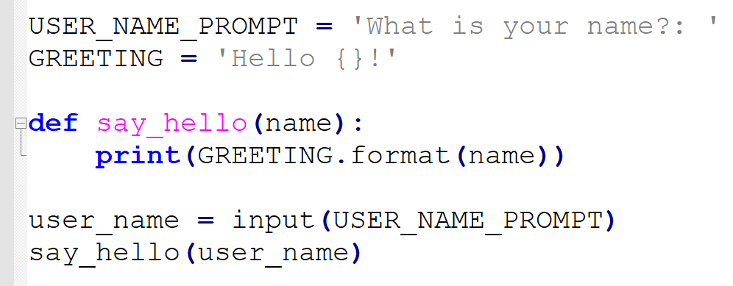
Constants - Example

Slide 34
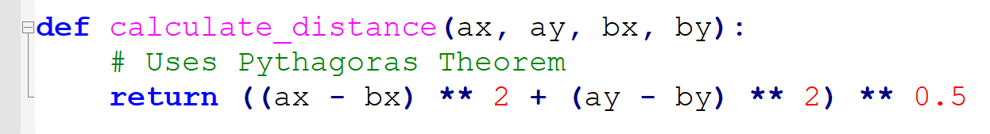
Comment Lines
An easy way to explain your code to a reader, is using comment lines.
Comment lines begin with a hashtag (#) and should be above the line being explained.

Slide 35
Docstring
A docstring is a documentation of a function – explaining exactly what the function does.
Every function should have a docstring.
The docstring is defined by using a multi-line triple quotes string, beneath the function definition line, before the function body.
Every docstring has 3 parts:
Explanation of what the function does.
Explanation of every parameter the function receives, and their expected type.
Explanation of what the function returns, and the return type.

Slide 36
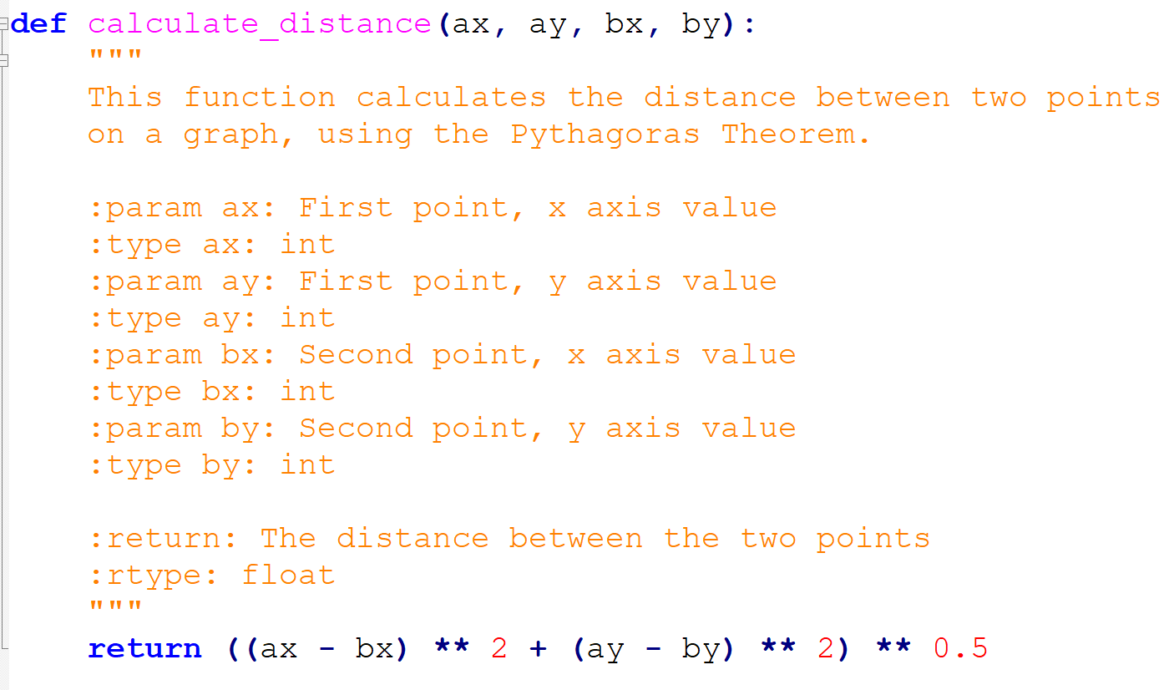
Docstring - Example

Slide 37
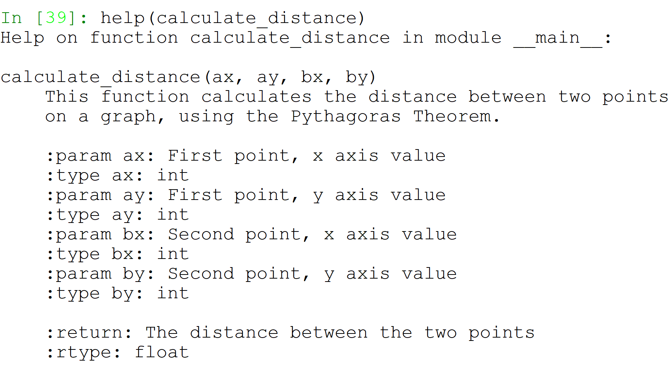
Docstring in Help / ?
This docstring now appears whenever help / ? are called:

Slide 38
Why We Need Docstrings
Let’s remember how we learned to use the input function.
What did we need to know?
What the function does
What the function receives
What the function returns
Did we need to know exactly how it does this? No!
Our docstrings let others use our functions, without having to understand everything about them.
From now on, all functions should have docstrings.

Slide 39
Can A Function Call Another Function?
Of course!
This can help us divide our code into logical chunks!

Slide 40
So why do we need functions?
Exit the Presentation and open the file entitled triangle_perimeter_functions.py, listed in the TrainerPS under this Presentation.
Look at the file – isn’t it beautiful?

Slide 41
Recursion
Recursion is a way of solving a problem.
Recursion happens when, during the execution of a function, the function calls itself.

Slide 42
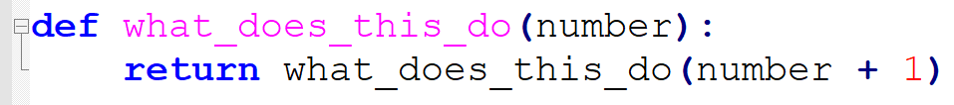
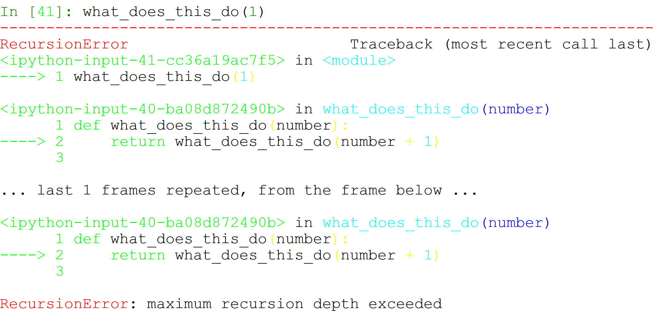
Recursion Creates a Loop!
What will happen if we execute this function?
Notes:
This means that the loop never stops, therefore, it will never return a value!
We don’t want it to continue forever, we want it to stop somewhere!

Slide 43
Solving Factorial Using Recursion
A factorial of a number (which is symbolized as the ! sign) is a multiplication of all whole numbers leading up to the number, including itself.
n! = 1 * 2 * 3 * … * n-1 * n
3! = 1 * 2 * 3
6! = 1 * 2 * 3 * 4 * 5 * 6
We will use recursion to solve this!

Slide 44
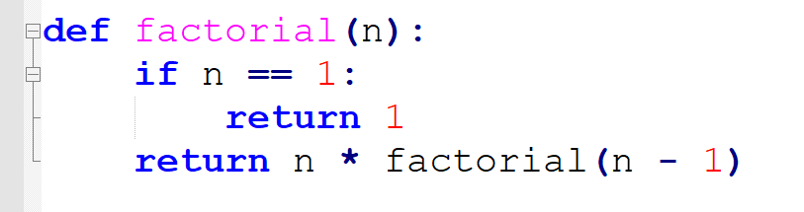
Solving Factorial Using Recursion (cont.)
Every recursion needs:
A loop in function execution (a function calling itself)
A stopping rule (when to stop the loop)
2
1

Slide 45
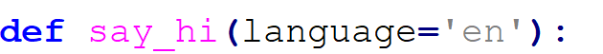
Default Arguments
Sometimes we will want a function to receive a default value.
This is very useful when one parameter is almost always the same value, but you still want to give the function more possibilities.
This is done by using the “=“ sign after the parameter name.
This means that when language is not defined (no input is given to the function), language will be ‘en’. But if language is defined, it will change to the chosen input.

Slide 46
Default Arguments (cont.)
There is no space surrounding the = operator in default arguments.
The chosen default argument should always be the most used option!
This is so that we will actually enjoy not having to input the argument.
Default arguments are always at the end of the argument list:
GOOD: def foo(a=1, b=2, c=3)
def foo(a, b, c=3)
def foo(a, b=10, c=100)
BAD: def foo(a=1, b, c)
def foo(a=5, b, c=10)

Slide 47
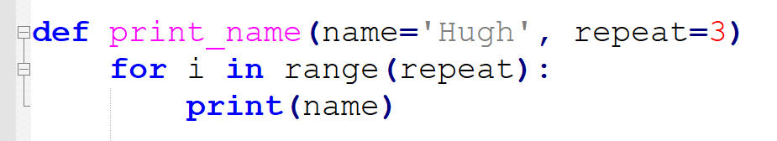
Default Arguments - Example
Let’s take this function:
What will this print when executing:
print_name()
print_name(“Mohammed”)
print_name(“Saoud”, 5)
print_name(repeat=5)
print_name(repeat=10, name=“Abdullah”)
print_name(5)
Notes:
Hugh 3 times
Mohammed 3 times
Saoud 5 times
Hugh 5 times
Abdullah 10 times
5, 5 times

Slide 48
Main Function
All re-usable code should be in functions.
That leaves only the code that activates those functions – runs them one after the other.
These lines of code should be in their own function, named main. This function should be at the end of the code.
This means that all of our code is now either constants, or in functions.
The main should be so simple, and so readable, even my mom would understand what it does!
Good news: This function is the only one that doesn’t need a docstring! This is because it shouldn’t do anything new – it should only activate other functions.

Slide 49
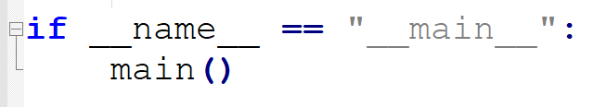
Last thing…
At the end of our code, we will write this:
This executes your main function.
Its OK that you don’t understand why we need this condition. Just do it. We’ll understand in the future!

Slide 50
Example
Exit the Presentation and open the file entitles secret_treasure.py, located below the presentation in the TrainerPS.
It has a very easy main() function, that is easy to read and understand.
The rest of the code is also inside functions.
It ends with our if __name__ == ‘__main__’: statement.

Slide 51
Summary
Creating Basic Functions
Executing Functions
Defining Parameters and Giving Arguments (single/multiple)
Returning Values (single/multiple)
Scopes
Constants
Docstrings
Recursion
Default Arguments
Main Function and if __name__ == “__main__”

